Slide 1
Graph Neural Networks and Applications
Jwalit Patel

Slide 2
AGENDA
Why Graph???
Introduction
Working
Results
Summary

Slide 3
Why graphs
let's begin with developing an understanding for the fake news data set when you think about it fake news detection is not really a graph problem it sounds more like a natural language processing task so why should we even consider using graph based deep learning models for this we can actually combine a language model with a graph model to improve fake news detection based on the retweeting pattern and the preferences of each node we can increase the quality of the predictions what we try to do here is to detect fake news based on structural features as well as language features what we however do not do is fact checking which means comparing the knowledge contained in a piece of news with the real world or to put it differently we don't assess the truthfulness of the content of an article we just look at some patterns and try to predict if this corresponds to a typical fake news article

Slide 4
GRaph Data Visualization
UPFD DATASET

Slide 5
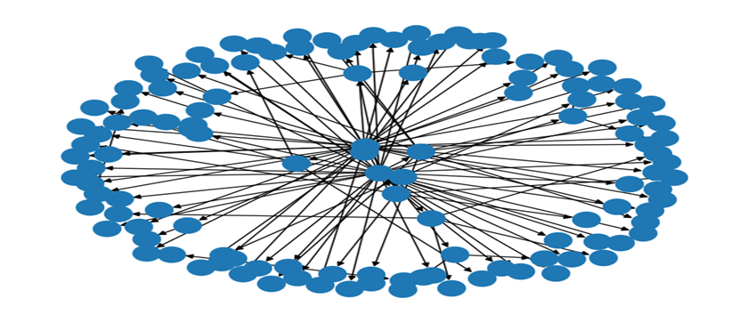
GRAPH FOr content model

Slide 6
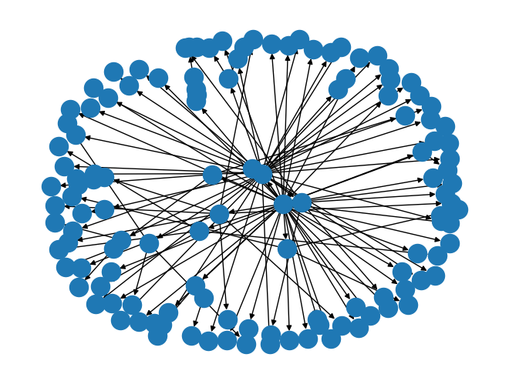
Graph for Bert Data

Slide 7
Introduction

Slide 8
Fake NEWS CLassification using GNN
Fake news detection is a critical task in today's information age, where misinformation and misleading content can spread rapidly across various platforms.
Graph Attention Network (GAT) Convolution, an advanced variant of graph neural networks, has emerged as a powerful approach for addressing this challenge.
By leveraging graph structures and attention mechanisms, GATConv provides a promising solution for detecting fake news. In this introduction,
we will explore how GATConv can effectively analyze relationships and capture important features within the network to improve the accuracy of fake news detection models.

Slide 9

Working
Downloading
Downloading the data
Data is the form of embeddings
"Content" data consist of spacy embeddings with user profile
"Bert" data consist of BERT embeddings
Visualizing Graph using networkx library
Adding data to DataLoader
Creating
Creating GNN Model using GATConv layer
Training and Testing
Visualizing
Adding
Comparing with true labels
Checking
Checking the predictions made

Slide 10
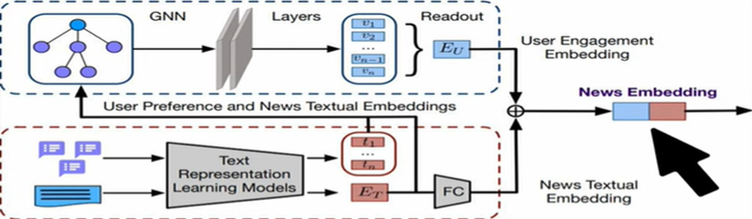
Model architecture

Slide 11
Model functioning
Step 1:
Step 2:
Final step:
With a GNN, the news textual embedding and user preference embedding can be taken as node features.
Given the news propagation graph, most GNNs aggregate the features of its adjacent nodes to learn the embedding of a node. Like previous GNN-based graph classification models
we apply a readout function over all node embeddings to obtain the embedding of a news propagation graph.
The readout function makes the mean pooling operation over all node embeddings to get the graph embedding (i.e., user engagement embedding).
We fuse the news textual embedding and user engagement embedding by concatenation as the ultimate news embedding to enrich the news embedding information.
The fused news embedding is finally fed into GNN(GATConv) Layer with two output neurons representing the predicted probabilities for fake and real news.
The model is trained using a binary cross-entropy loss function and is updated with SGD.

Slide 12
SUMMARY
The Experimental results demonstrates the advantage of using data with news and profile embeddings as it provides more information to the model.
In conclusion, GNNs offer promising capabilities for fake news detection by capturing relationships, incorporating contextual information, and leveraging transfer learning. By considering the network structure and interactions, GNNs can provide a valuable tool in combating the spread of misinformation. However, it is important to carefully design and adapt GNN models to address the specific challenges and limitations of fake news detection tasks.

Slide 13
THANK YOU
Jwalit Patel
Degree: M.SC. AI and MLOps
Adviser: SHILPA KADAM

